Slide 1


Movie Evaluator
Dhruv Patel
University at Albany
Tejas Shah
University at Albany
Kushal Patel
University at Albany
ICSI 531 Data Mining
Guided by
Professor :Feng Cheng

Slide 2
Dataset Used
We collected tweets using Twitter rest API.
      Social Networking and Microblogging Service.
      Enables user to send and read tweets.
      It helps to link up with a community of people who share same interest.

Slide 3
Introduction
Movie’s success depends on people’s opinion towards it.
Movies released every week: 15(approx.)
In this project we are trying to identify that from the multiple movies releasing on same week which movie will gain more popularity.
Our project includes prediction using Twitter Data and analysis of prediction results.
The more number of positive tweets shows more popularity of movie.

Slide 4
Data Collection
Data Collection:
      We used Twitter Rest API to collect tweets.
      Collected more than 3000 tweets for 20 different movies.
Data Pre Processing:
      Removed unnecessary data from collected tweets like URL.
      Removed duplicate tweets form the collected tweets
      Generated different files based on different movies
Structure
Marketing strategy is the goal of increasing sales.
Data analysis which summarizes data. sed an graecie prompta invenire, in gubergrenodsfdfdf

Slide 5
Methodology
Data Collection
Structure
Recommending Popularity
Marketing strategy is the goal of increasing sales.
Data analysis which summarizes data. sed an graecie prompta invenire, in gubergrenodsfdfdf
Data Pre Processing
Dividing Tweets for Training and Testing
Classifying Tweets
(SVM)

Slide 6
Training and Testing Data
Structure
Dividing Tweets into Training and Testing
Training Data:
        Assign Rating to 15 movies based on rating between 1 to 5
        We picked 1 to 5 rating based on IMDB ratings given to those movies
Testing Data:
        For testing data created the same feature set as training data set
Marketing strategy is the goal of increasing sales.
Data analysis which summarizes data. sed an graecie prompta invenire, in gubergrenodsfdfdf

Slide 7
Classification
We used SVM as Classification model and used training dataset as following
On classification graph :
      Feature Set: As a Feature set we used word count of all tweets of each movie for e.g. we took 10 most frequent words of that particular movie
      Class Label: Ratings given to 15 movies on scale of 1 to 5.
We applied this classification model to testing dataset of 5 movies, which will
give us the prediction rating of those 5 movies
Structure
Marketing strategy is the goal of increasing sales.
Data analysis which summarizes data. sed an graecie prompta invenire, in gubergrenodsfdfdf

Slide 8
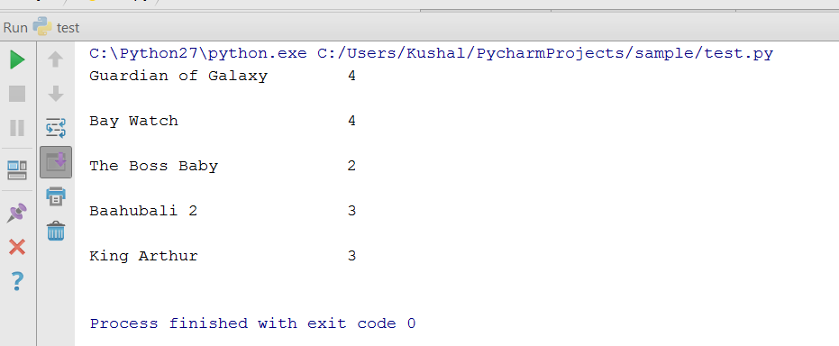
Recommending Popularity
After applying SVM model to testing data the results we got are as follows:
As a result we will get rating of those 5 movies on the count of 1 to 5 and from
that count we can say that the higher rating count will get more popularity.
Structure
Marketing strategy is the goal of increasing sales.
Data analysis which summarizes data. sed an graecie prompta invenire, in gubergrenodsfdfdf

Slide 9
Challenges We faced
Collecting unique tweets using rest API
It’s a time consuming process to collect huge amount of unique twitter data.
Language Barrier in tweet because of global geo locations.

Slide 10


Structure
Marketing strategy is the goal of increasing sales.
Data analysis which summarizes data. sed an graecie prompta invenire, in gubergrenodsfdfdf

Slide 11

Structure
Marketing strategy is the goal of increasing sales.
Data analysis which summarizes data. sed an graecie prompta invenire, in gubergrenodsfdfdf

